Slide 1

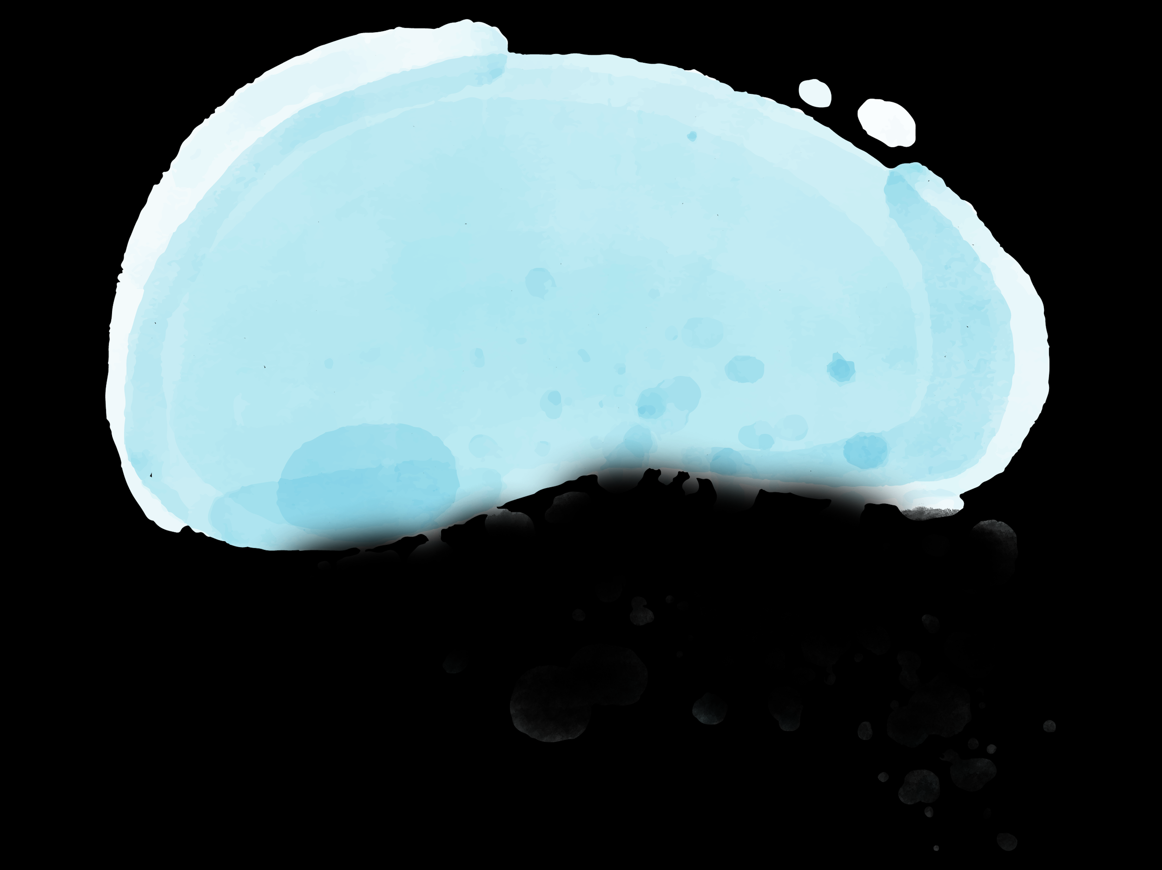
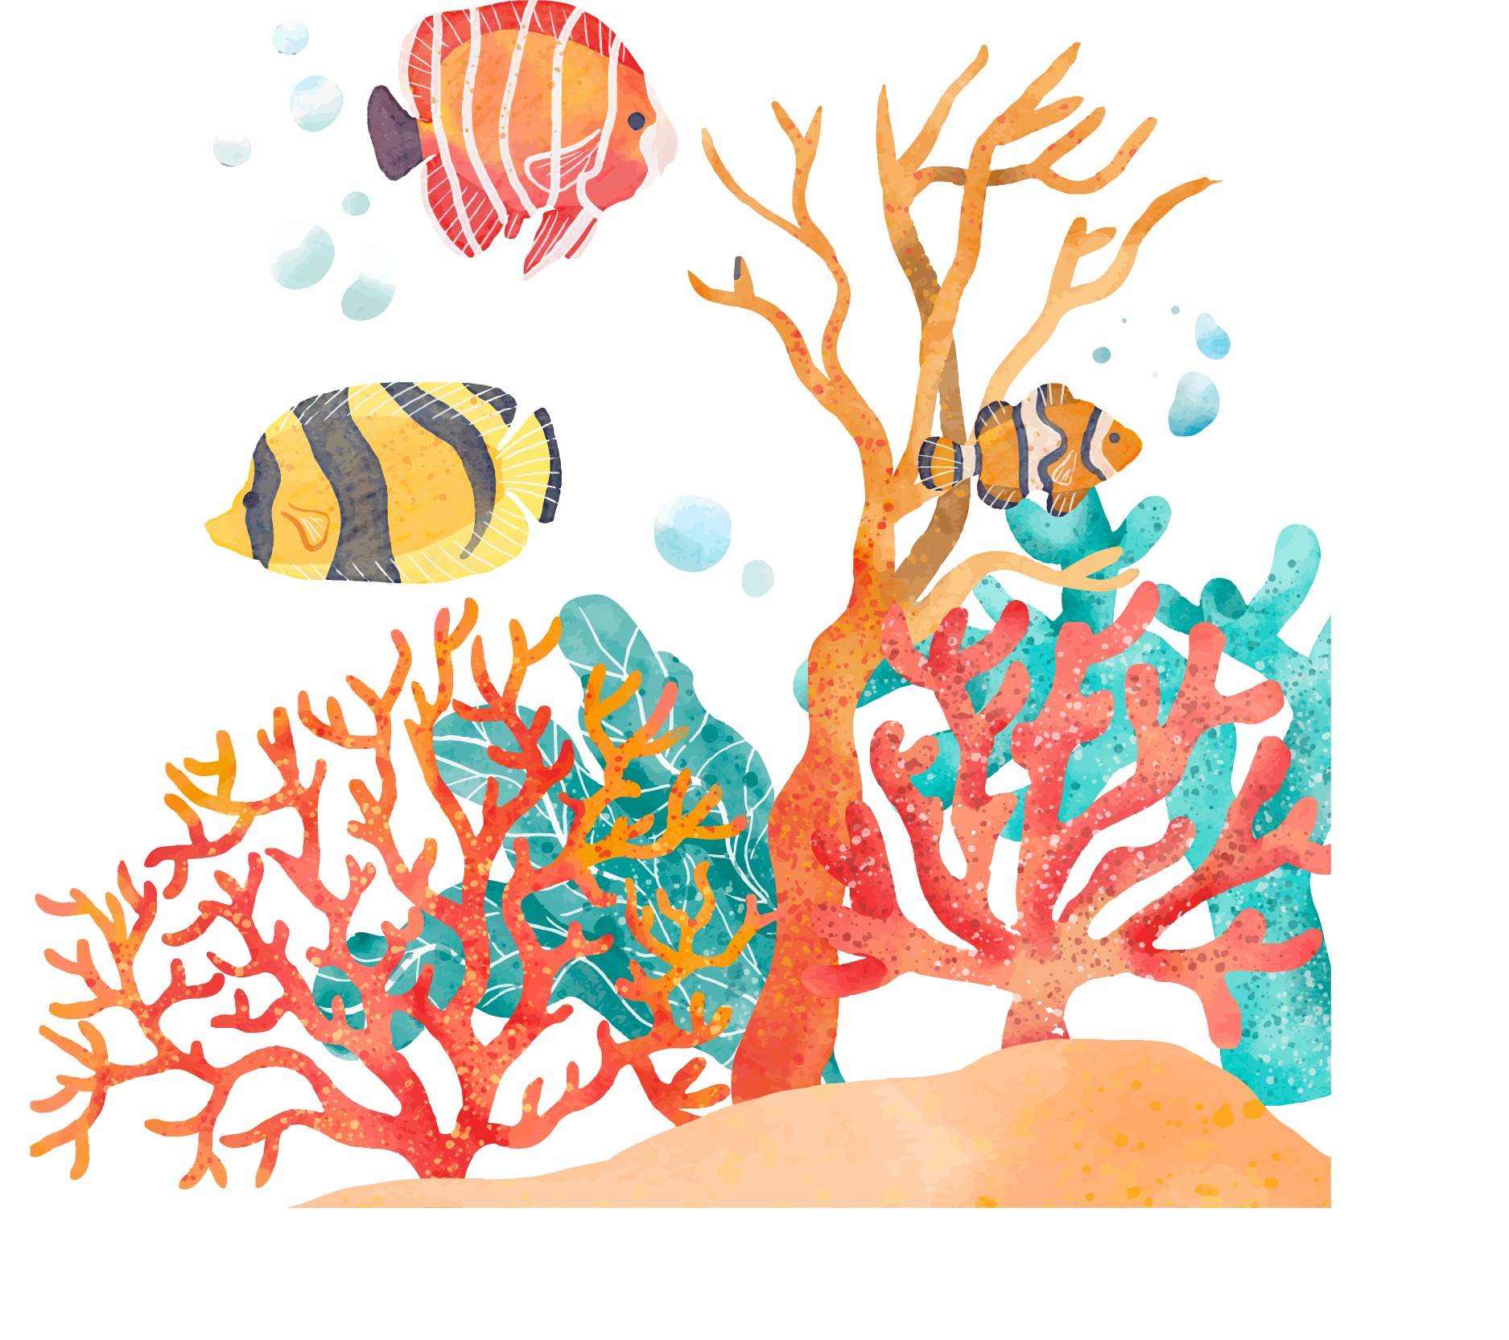


BIODIVERSITY CONSERVATION
For the benefit of All

Slide 2
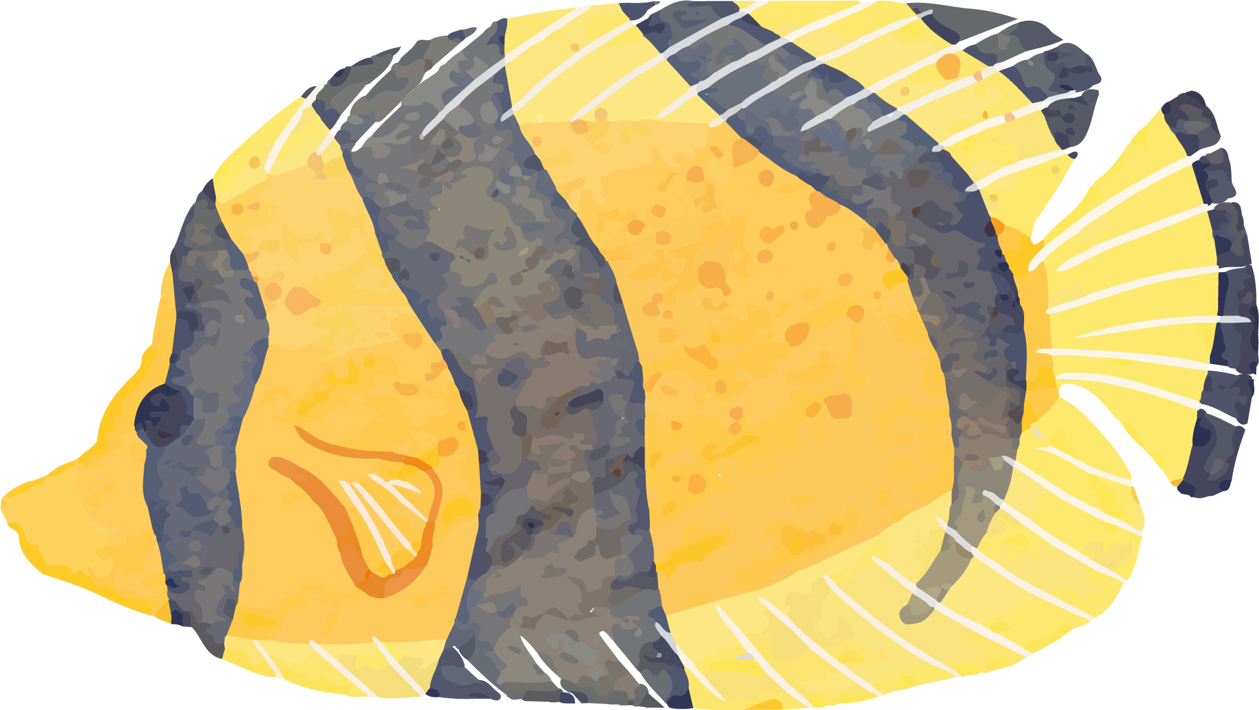
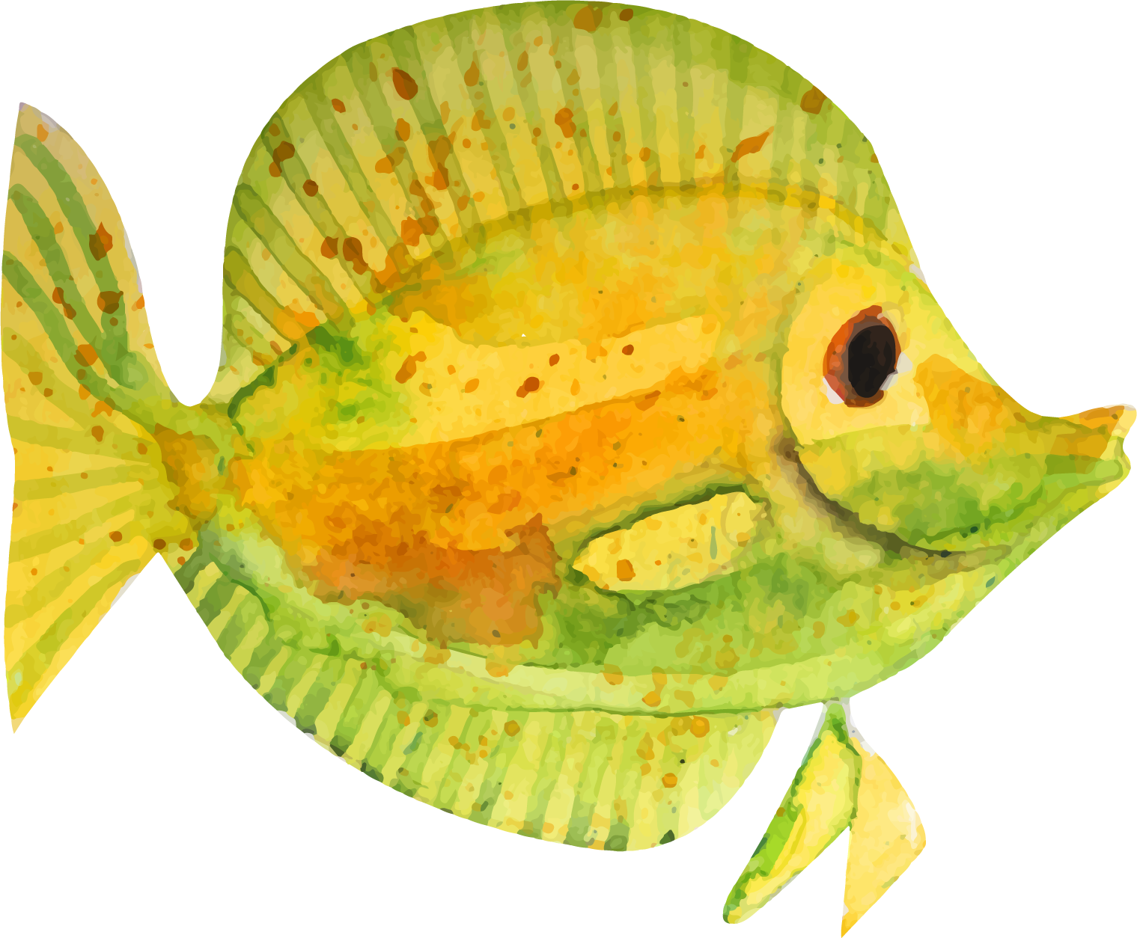
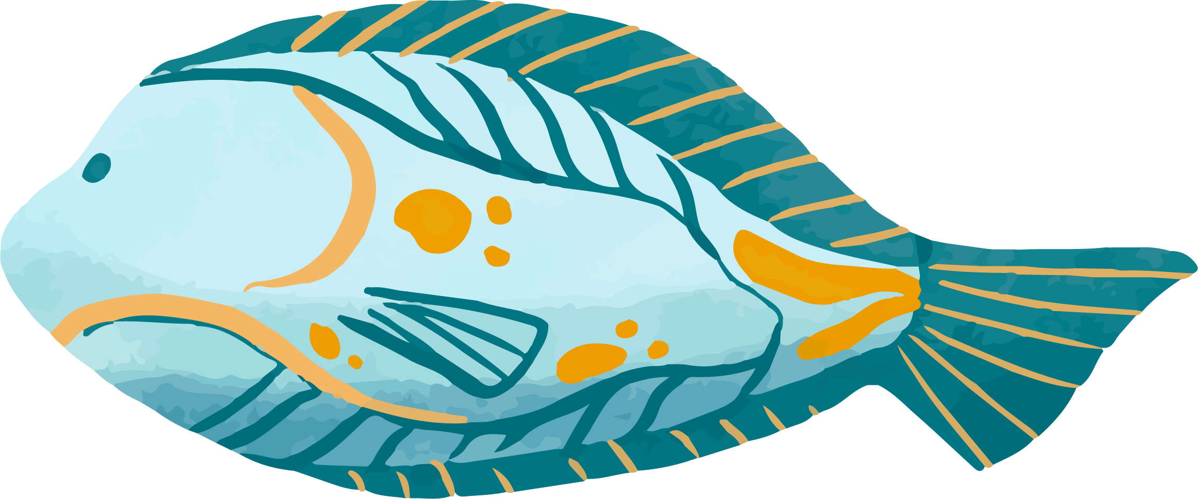

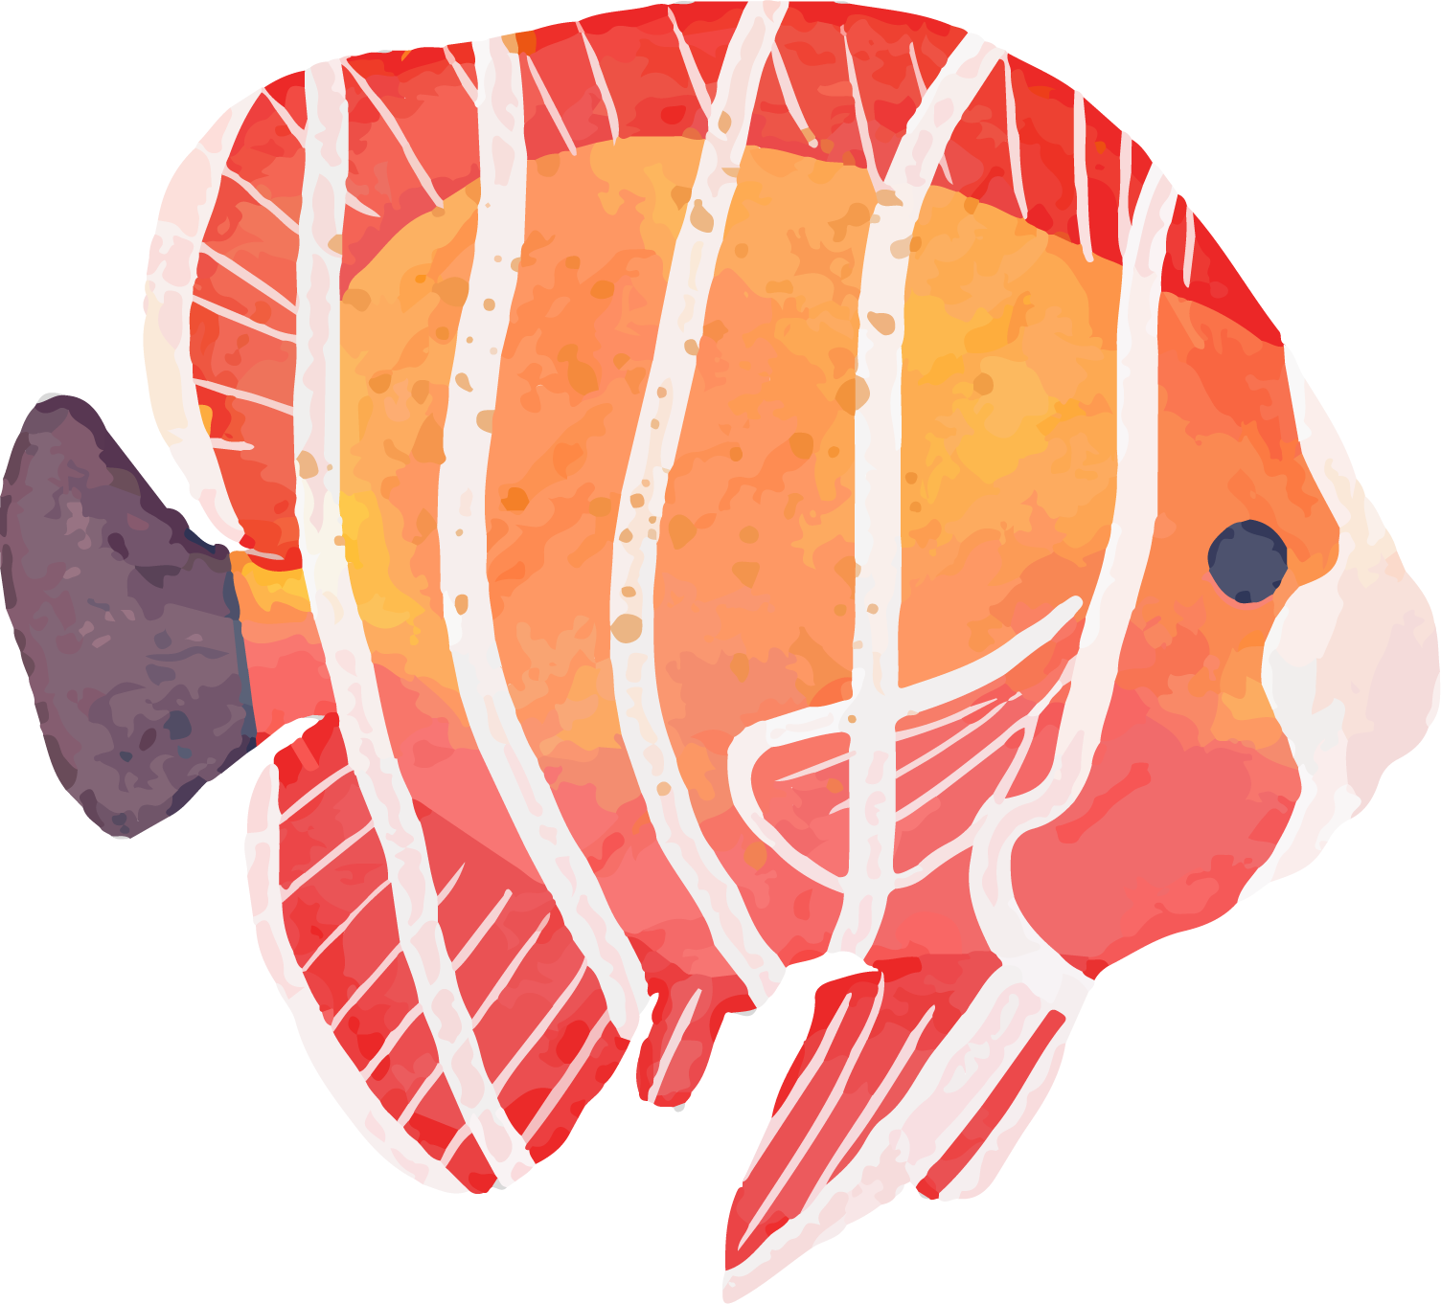
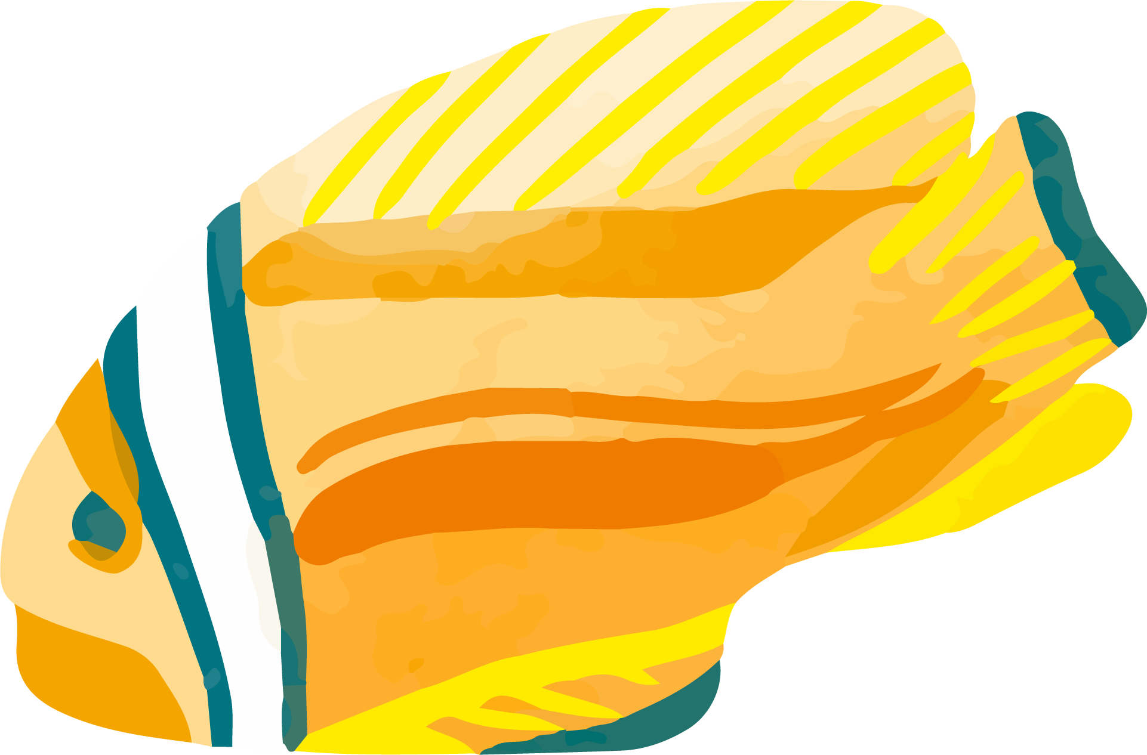
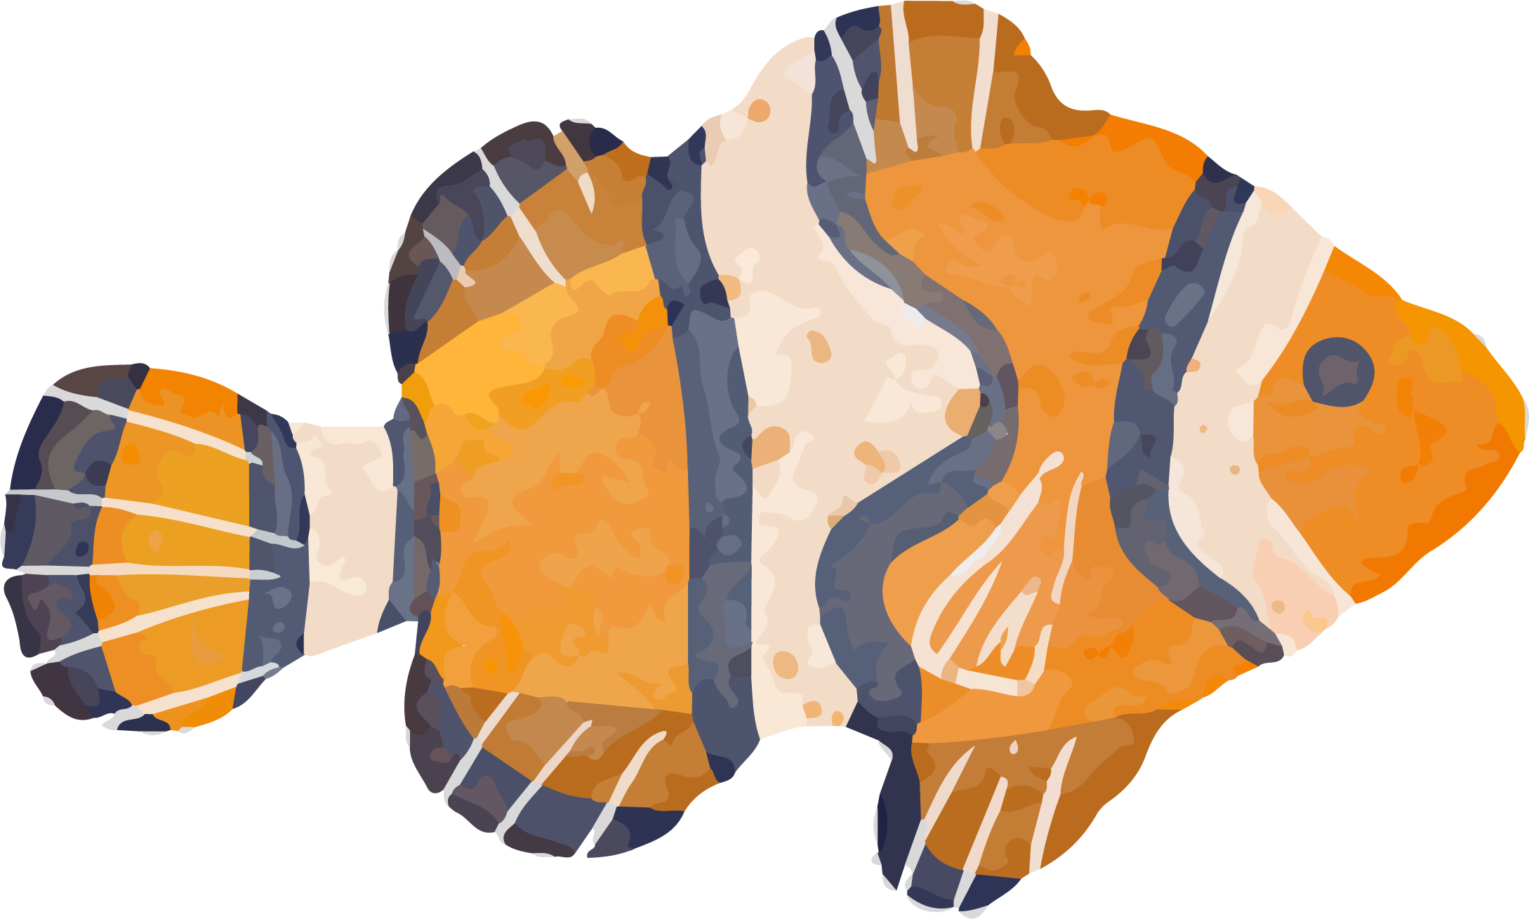
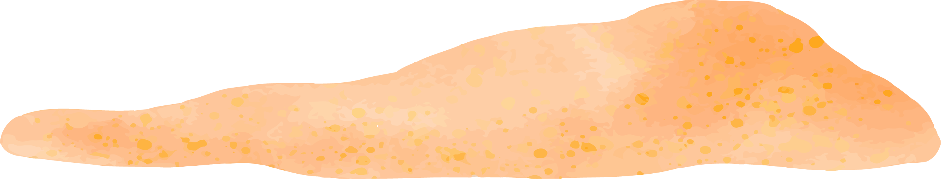
Biodiversity starts in the distant past and it points towards the future.
Notes:
Th diverse the environment, the better the society.

Slide 3

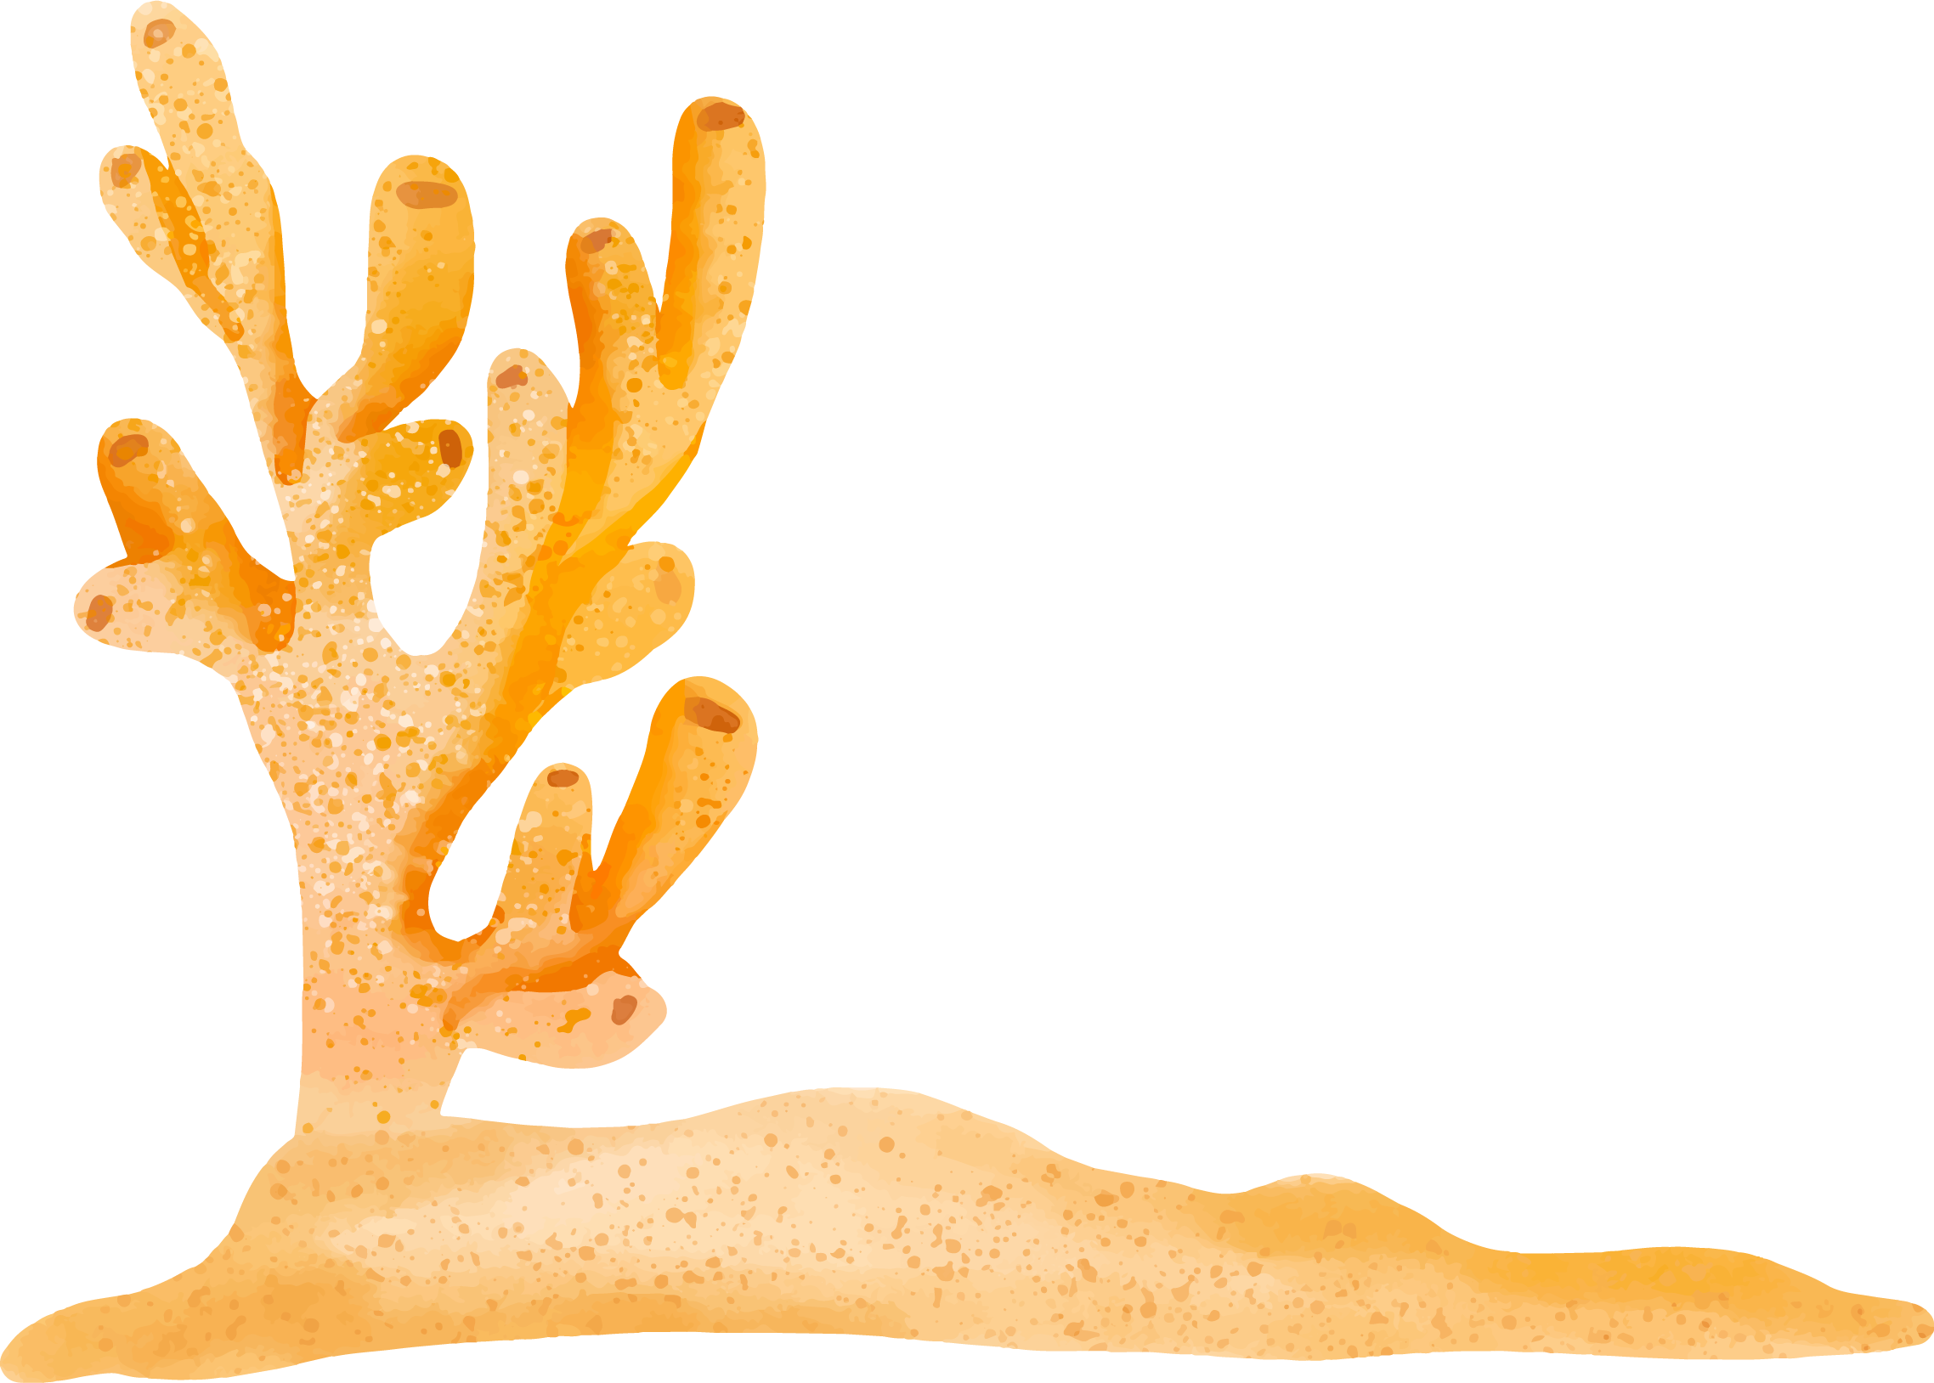

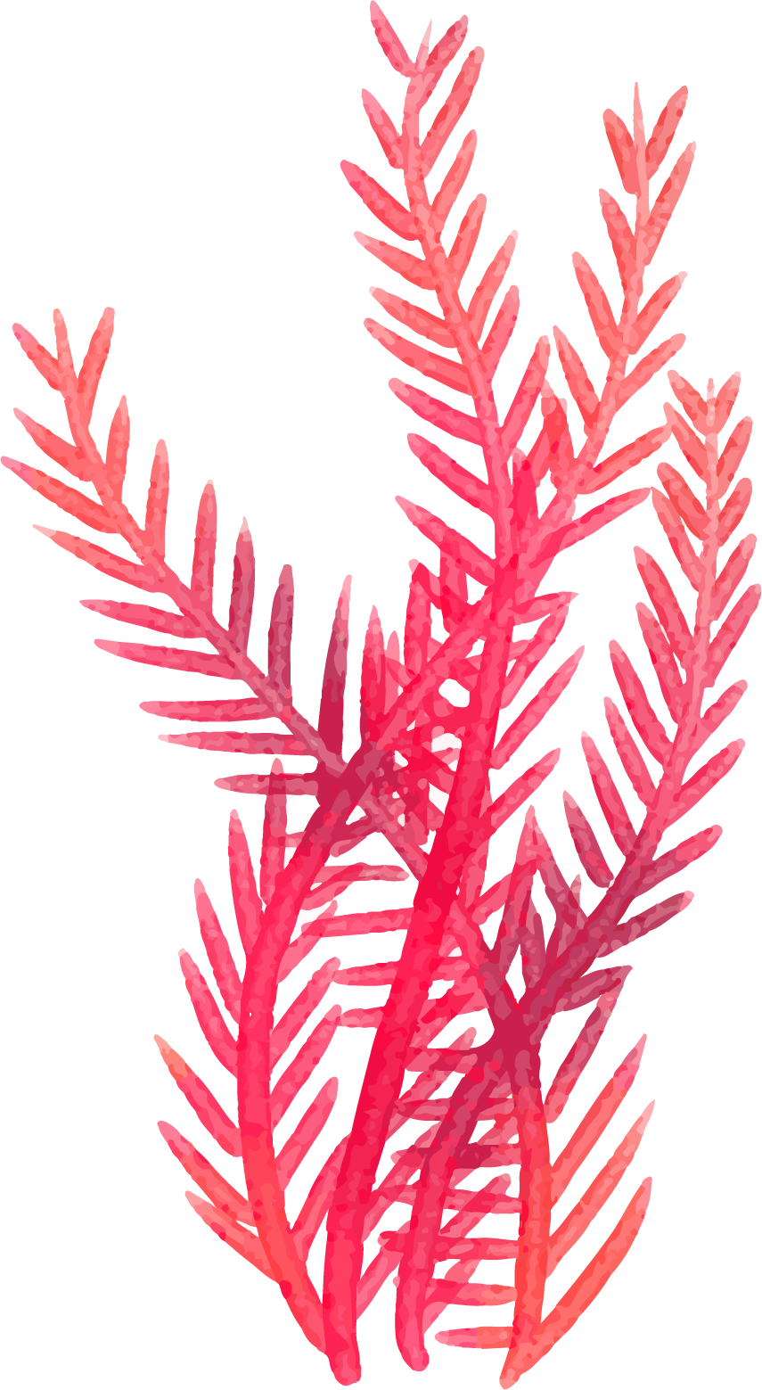
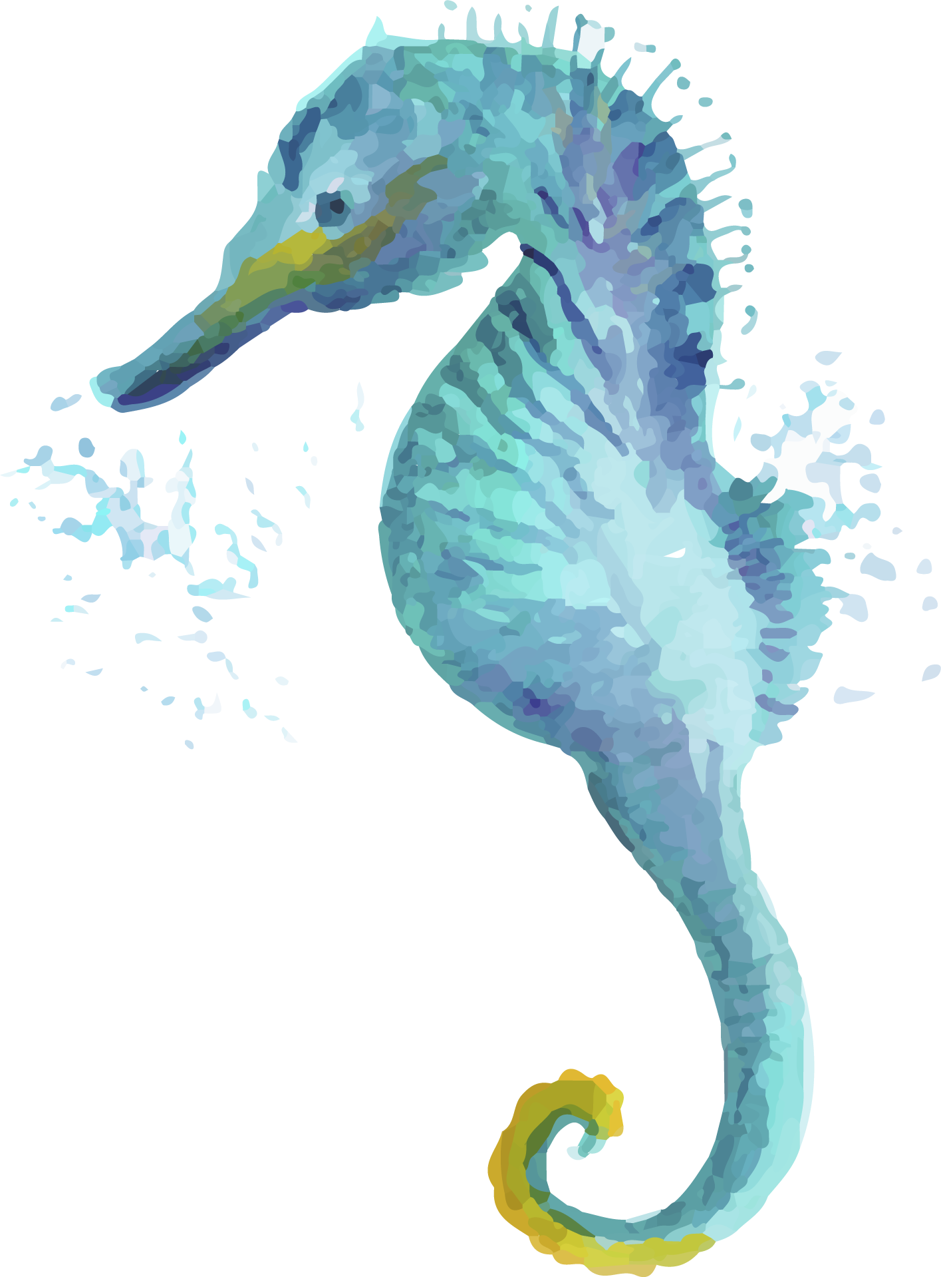
BIODIVERSITY
Variability among living organisms.
It is of three different levels
Genetic Diversity
Species Diversity
Ecosystem Diversity
Notes:
genetic diversity portray more adaptability and survival mechanism against adverse environmental conditions – this later proves to be highly important
Species diversity refers to the variety of organisms in the environment.
Species richness. It is the total number of species in a given region or locality.
It is relatively similar to species diversity except for the fact that it deals with the variations in ecosystems within a geographical location. From one region or country to another
These are all theory parts

Slide 4

REASONS FOR DECLINE OF BIODIVERSITY
1.Natural causes
At the end of Permian period (250 million years ago) a great disaster wiped ⅔ of all marine species and ½ of all plant and animal families.
2.Human caused reduction
Deforestation
Poaching of wildlife
Notes:
Now this Is very interesting
The great dying took out 96% marine speices, 70% land animal species.
Super continent pangea - ice age
The reasin is less clear !there are multiple thories
There are researchesrs saying metors, or sue to high volcanic eruption causing global warming, which then lead to high infrared signals entrring earth. Thus mutating plants and making it sterile.
Sulphur di oxide and Co2.
C02 got 20 times higher than today.
Other things include, since it was a single continnient, there was a big derert formend at center and reptiles came into play.
Volcano eruption went for 500 thousand years. Took 2 millions years to recobver.
Could you ever imagine that the reason for mass extinction was becuz of internal problems, and not meteors. That’s very deadly rite.
And with pur rising Co2 levels, even if we see the extinctrion tomorrow, nothing is surprising .
Right now, we humans are itself escalating that process. And if we keep heading the way we’re doing now, end is not far.

Slide 5
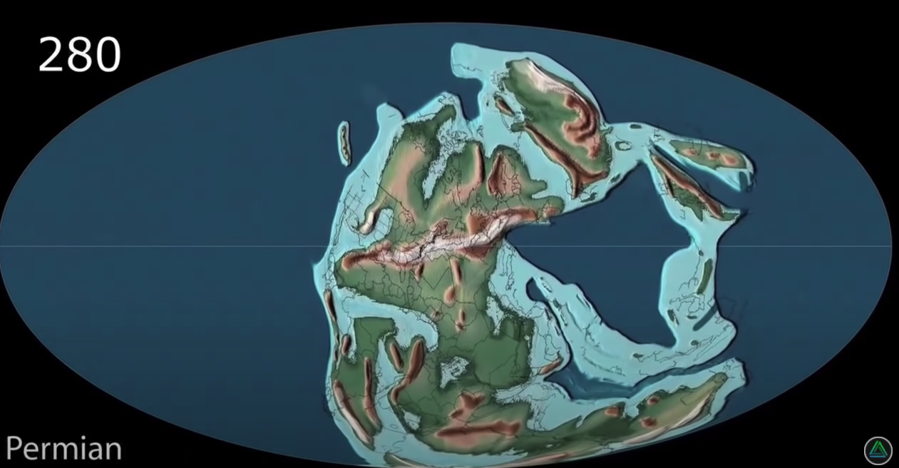

Slide 6
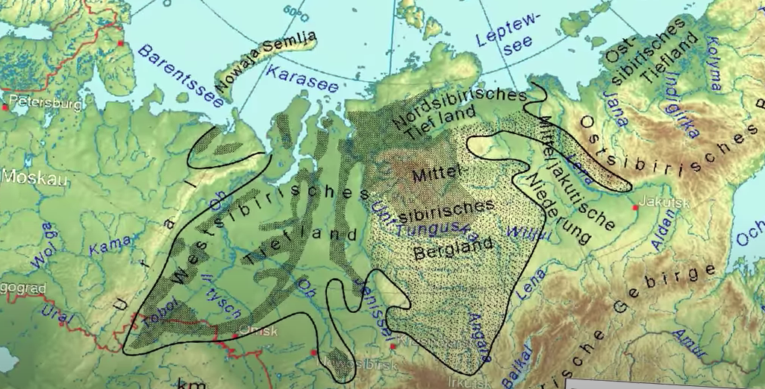
Notes:
Siberian traps

Slide 7
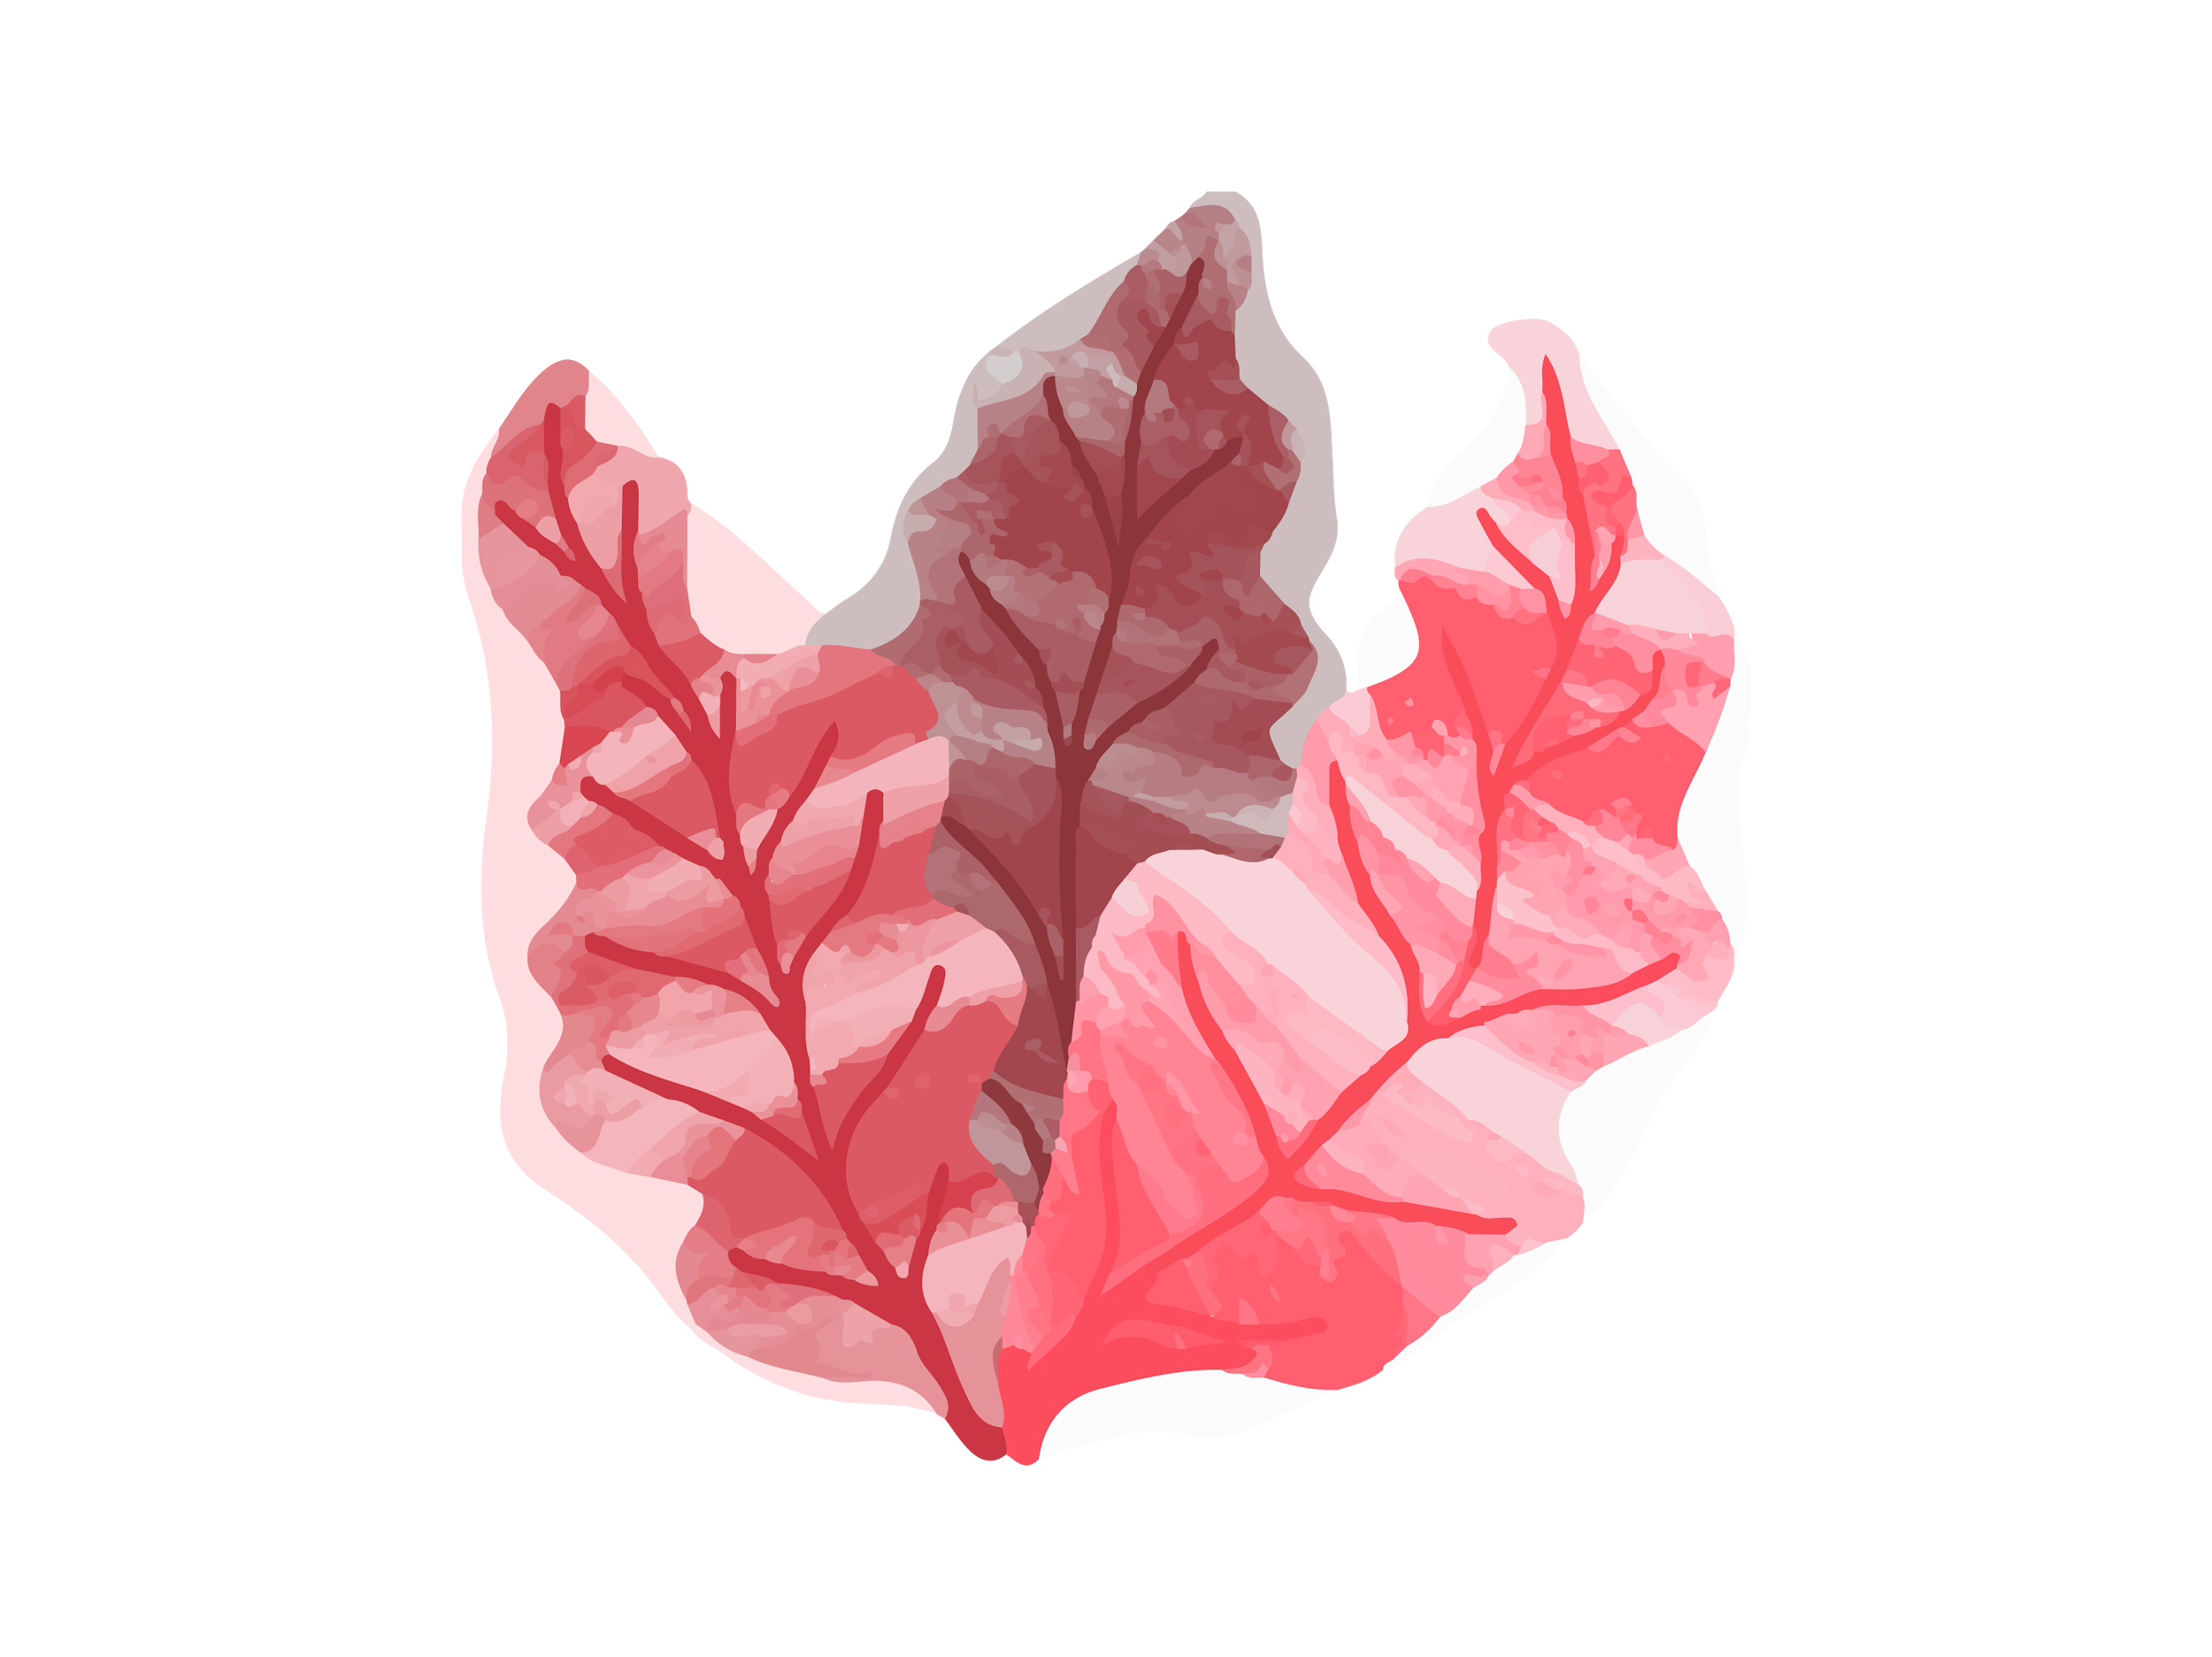
IMPORTANCE OF BIODIVERSITY CONSERVATION
01
03
Backbone for agriculture, aquaculture, animal husbandry
New sources of food, medicine and other human requirements.
02
04
New industrial developments and innovations
Save the races of endangered and endemic species
Notes:
From single sense to 6 sense..
Birds and worms…

Slide 8
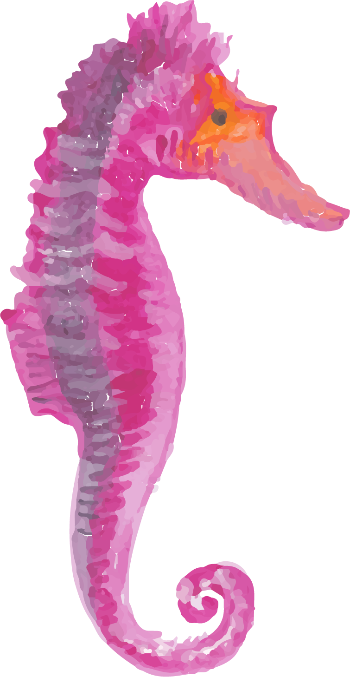
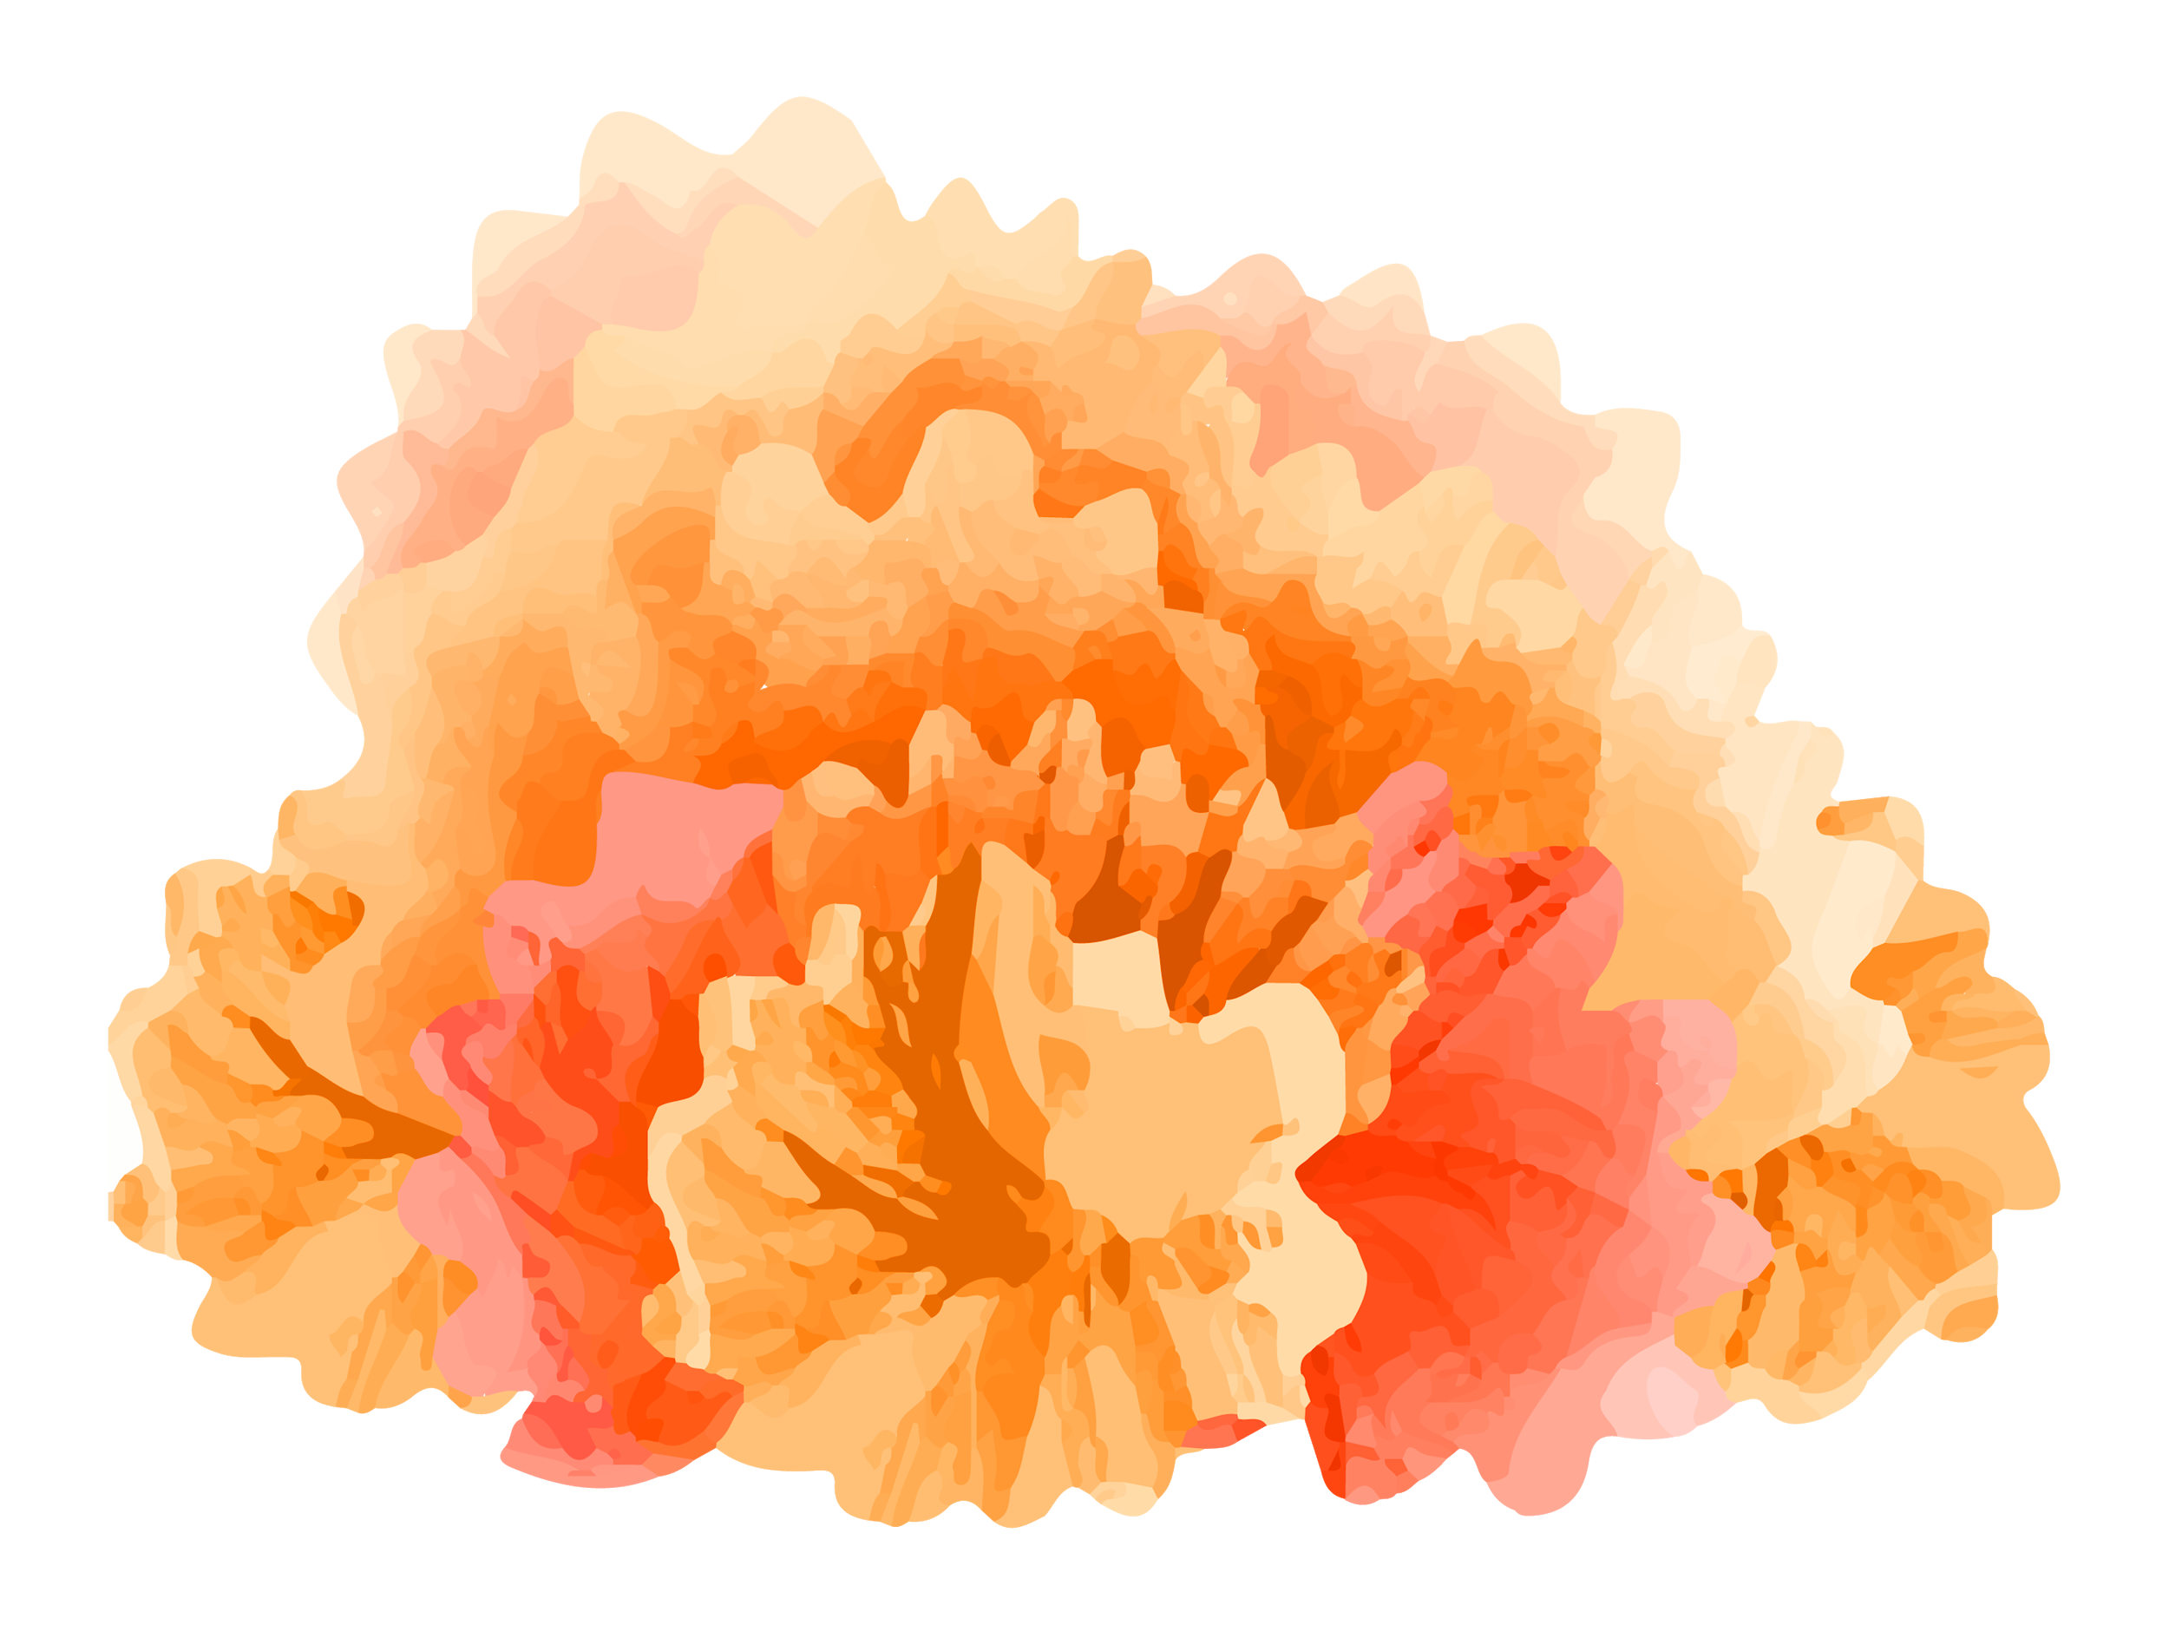
CONSEQUENCES OF LOSING BIODIVERSITY
Extinction of species may occur.
i.e Keystone species.
For example, the Orchid bees play a vital role in tropical forests by pollinating trees.
Notes:
No pollination and consequently less breeding in trees. Less

Slide 9
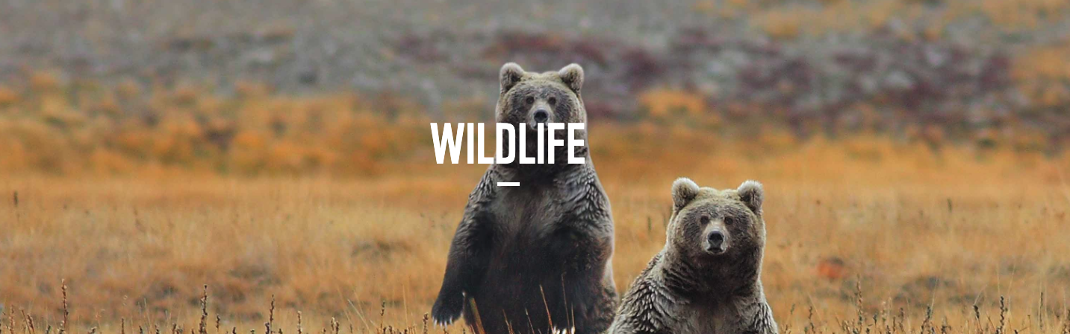
Endangered Species Fate is in the hands of just one species: Homo sapiens.
Notes:
Wildlife is disappearing on every continent, in every ocean, on land and underwater. And its fate is in the hands of just one species: Homo sapiens.
Human actions threaten wildlife in two main ways: by destroying and damaging the places where species live, and by using them in ways that are unsustainable.
Wildlife is an important component of the entire ecosystem and we want to see it thrive. WWF
But we need to do much more to halt and reverse the decline in the world’s wildlife. Ultimately, our own well-being and survival depend upon it.
For example ,

Slide 10
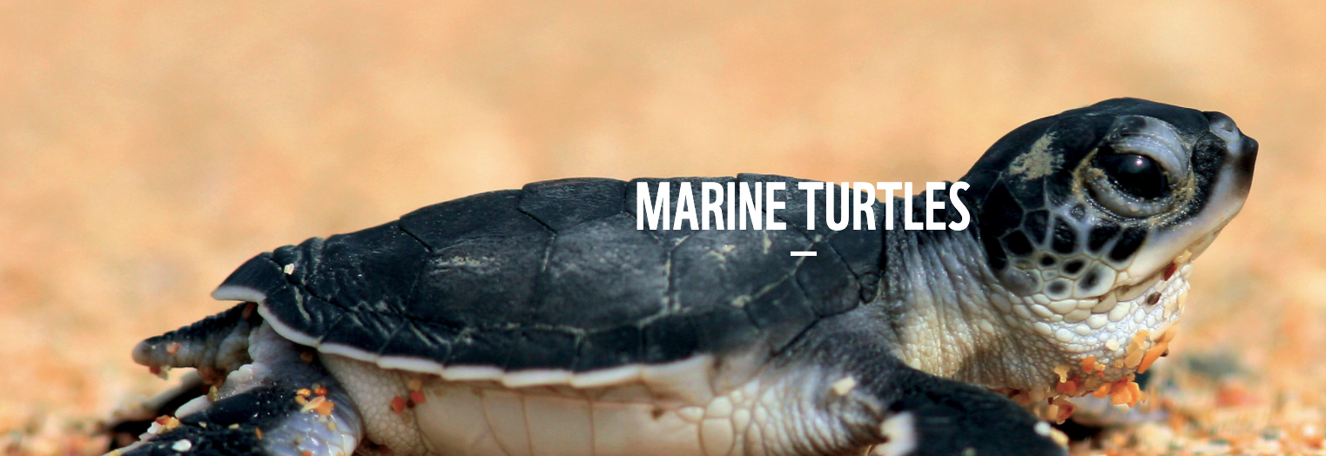
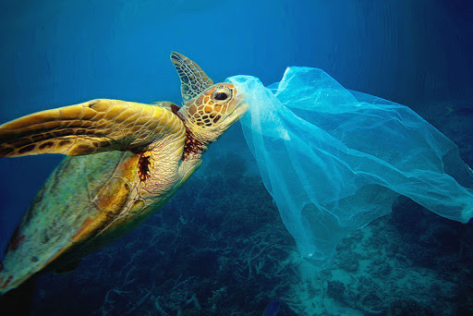
110 million years
Notes:
sea turtles have been living on planet Earth since the time of the dinosaurs? - around 110 million years.
What's amazing about sea turtles is that after years traveling the open ocean they return to the nesting grounds where they were born to lay their eggs. In their voyage from nesting to feeding grounds – some species will travel more than 1,000 miles.
But life is filled with danger for a sea turtle, especially the hatchlings. On the beach, birds, crabs, raccoons, even foxes will eat hatchlings. And if hatchlings make it to the ocean, they are still tasty snacks for seabirds and fish.
However, the greatest threats to sea turtles aren't from natural predators; they are from humans.
We had sterwas,

Slide 11
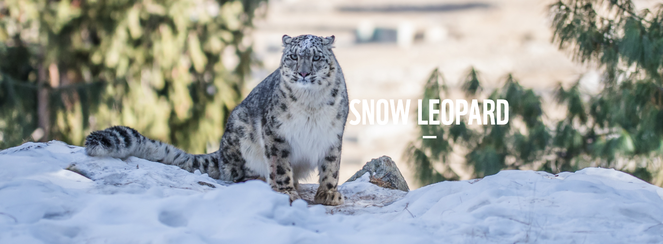
stealthy predators
Notes:
Snow leopards are solitary and elusive creatures that usually hunt at dawn and dusk. They’re stealthy predators, able to kill prey up to three times their own weight.

Slide 12
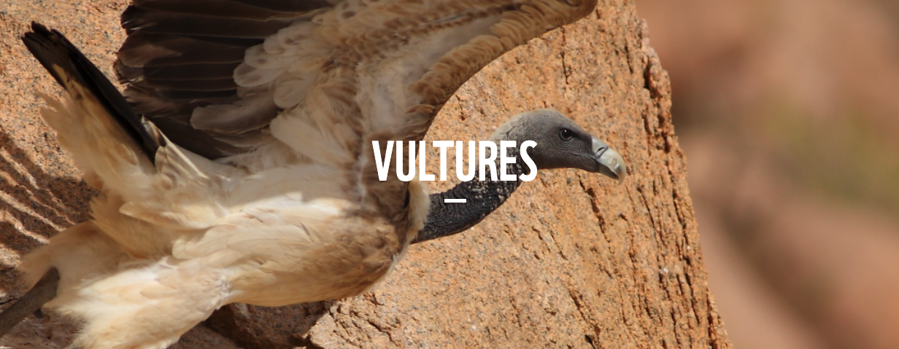
withstand diseases that would kill any other creature
Notes:
Vultures can fly effortlessly for hours at a time. They do so by gliding over thermal updrafts (warm rising pockets of air), grabbing a free lift. They can digest meat in any stage of decay, and withstand diseases that would kill any other creature.
Unfortunately, the vultures have been declining in Pakistan and are now critically endangered.
They effectively rid the landscape of rotten flesh or carrion and, in so doing, play a key role in the control of serious livestock diseases such as anthrax, tuberculosis and rinderpest.

Slide 13
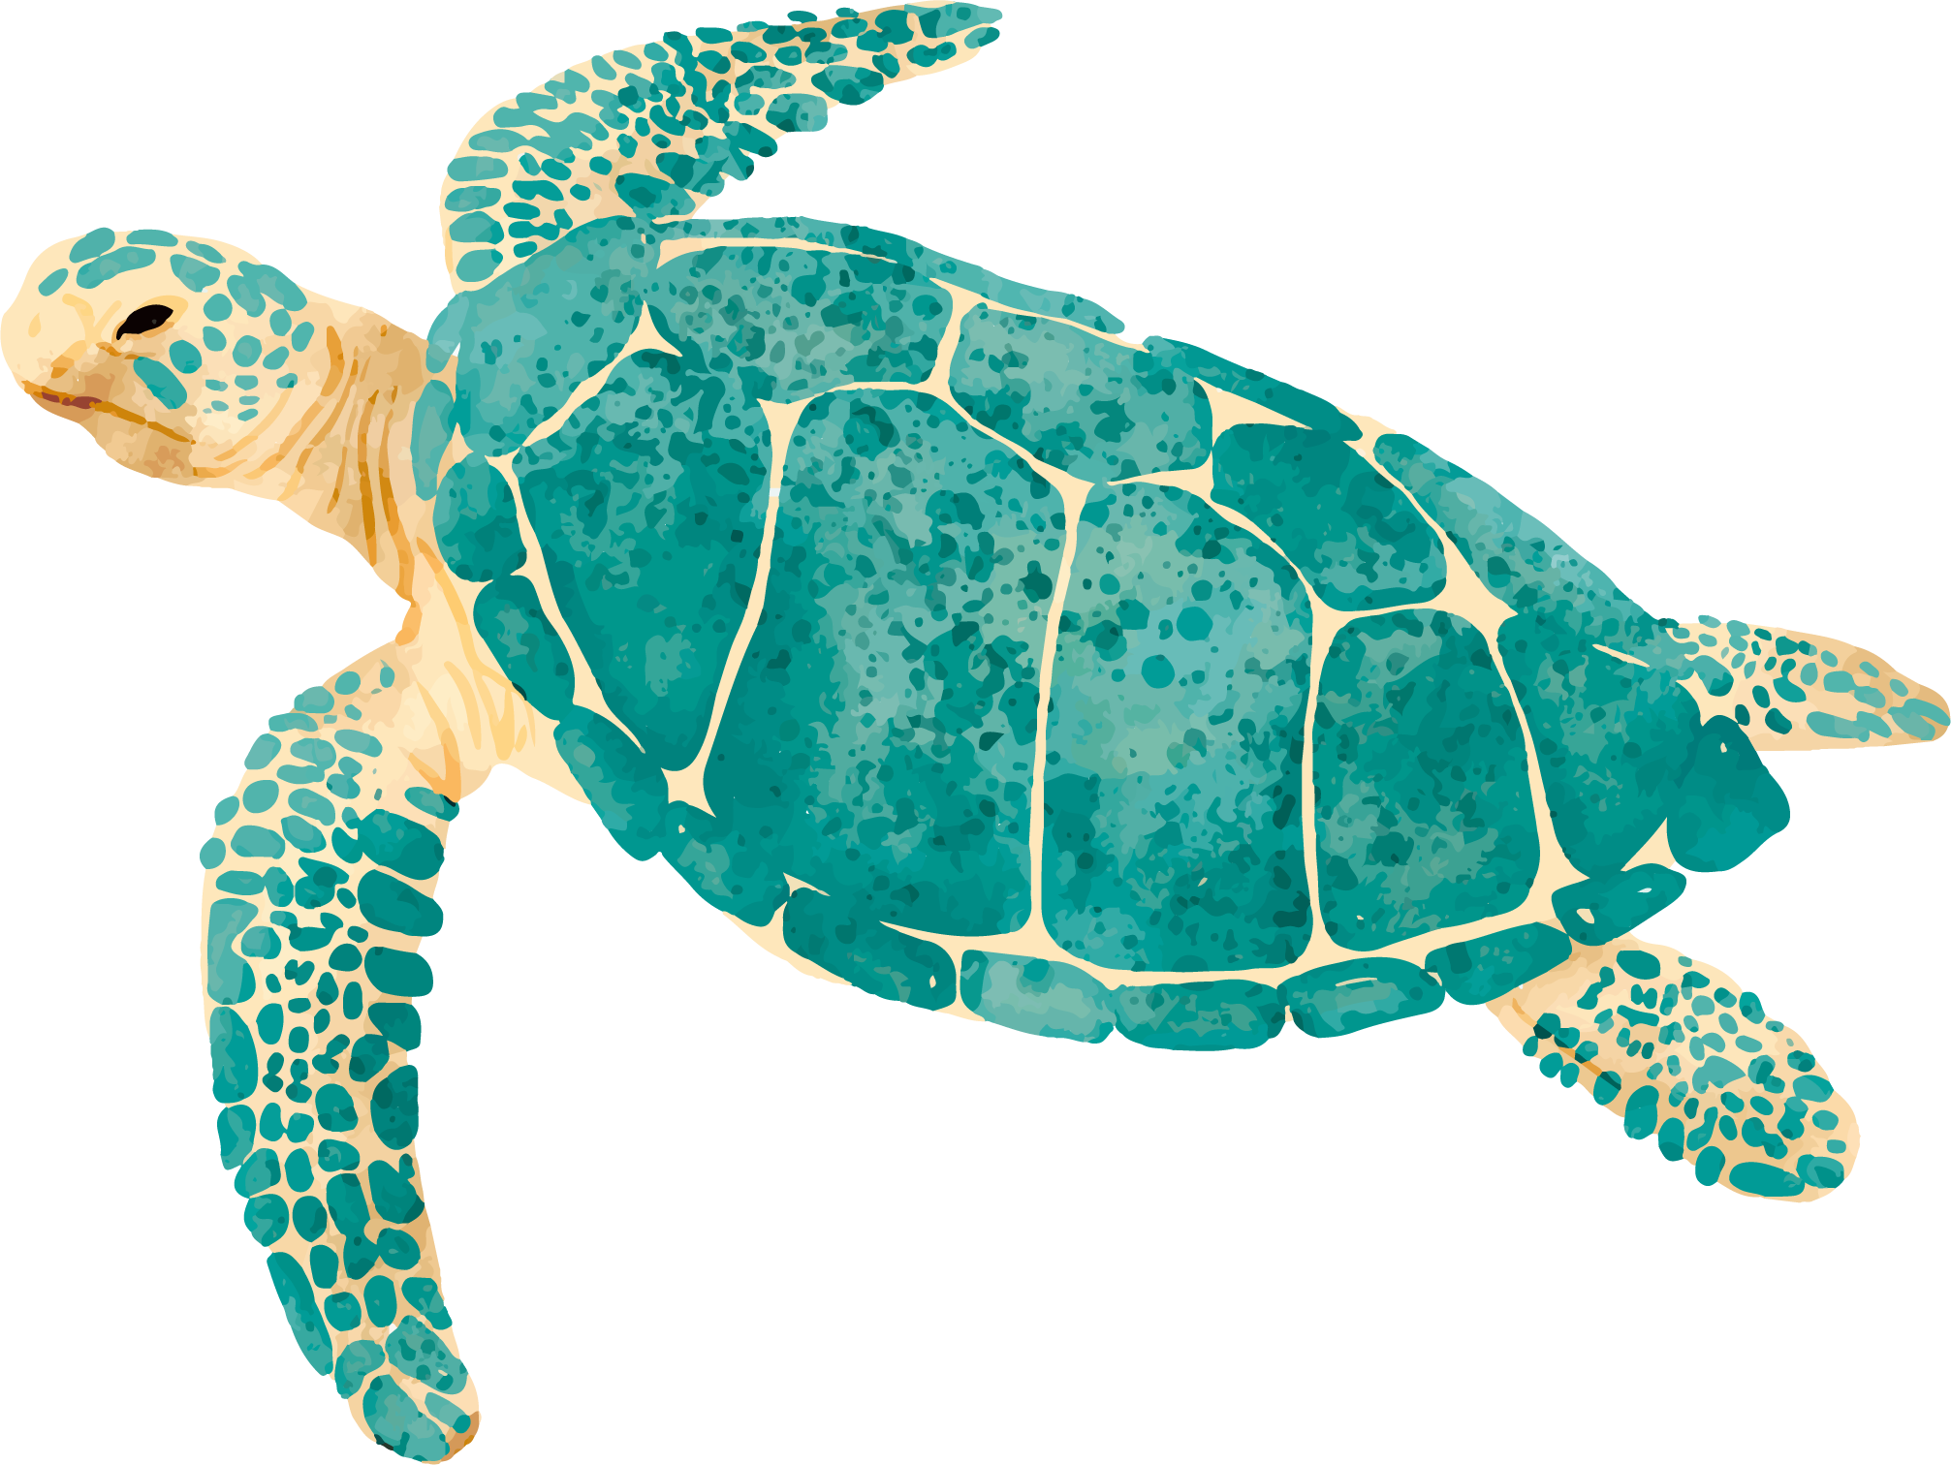
Biodiversity Conservation
International Conservation Strategies
Conserving hotspots. There are around 25 hotspots identified from all over the world.
National Conservation Strategies
India is one among the 12 Mega Biodiversity countries in the world. The Union Ministry of Environment and Forests formulated National Biodiversity Action Plan.
Notes:
India is taken big steps to save the endangered species,
Biodiversity hotspot is a term used in conservation to refer to an area with high biological diversity that is threatened by human activities
The area must have a certain number of species that are unique to that particular area

Slide 14
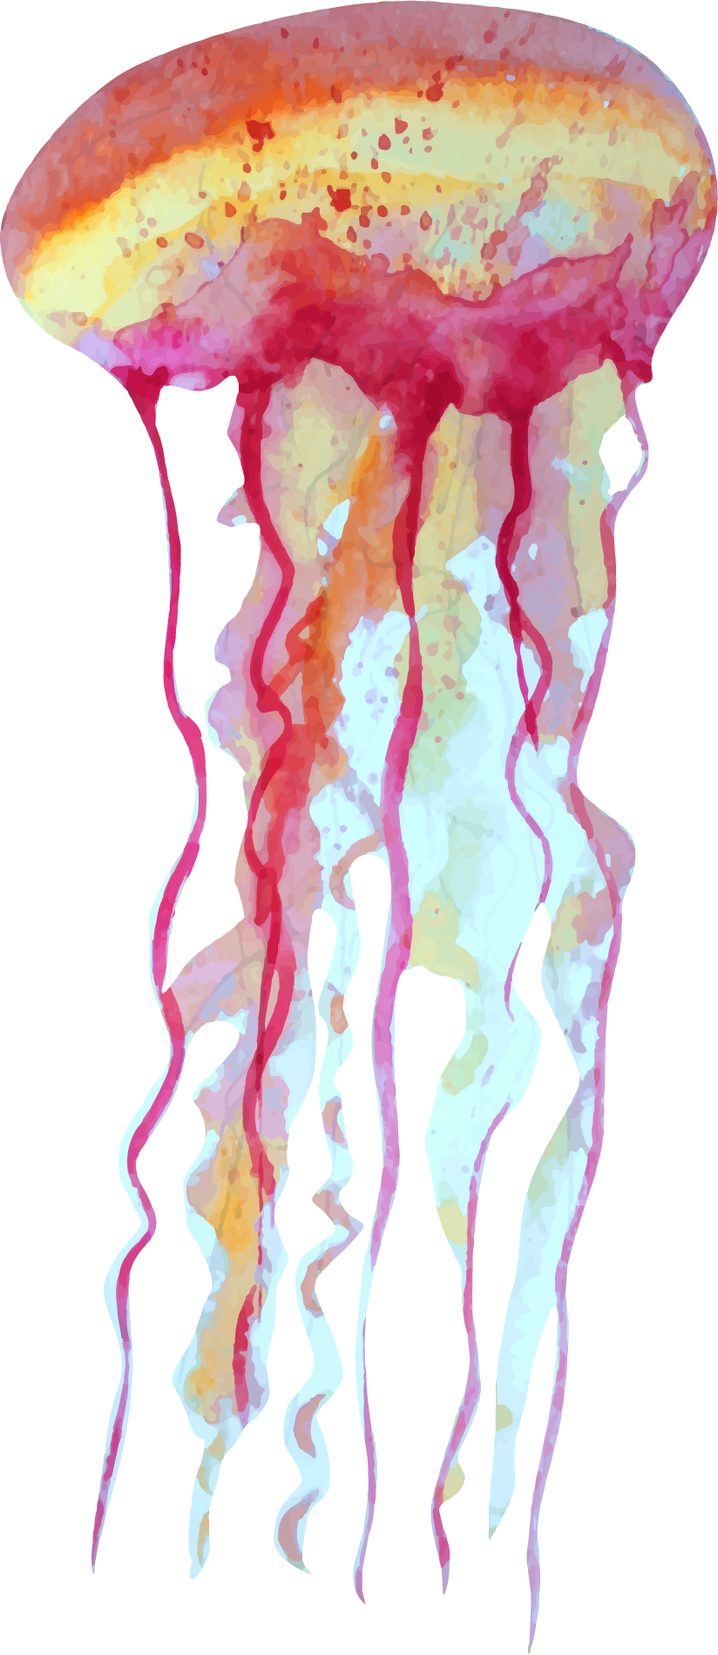

BIORESERVES
A bioreserve includes one or more protected areas that are managed to combine both conservation and sustainable use of natural resources.
Biosphere Reserve is an international designation made by the UNESCO.
Notes:
Biosphere reserves are 'learning places for sustainable development’.
understanding and managing changes and interactions between social and ecological systems

Slide 15
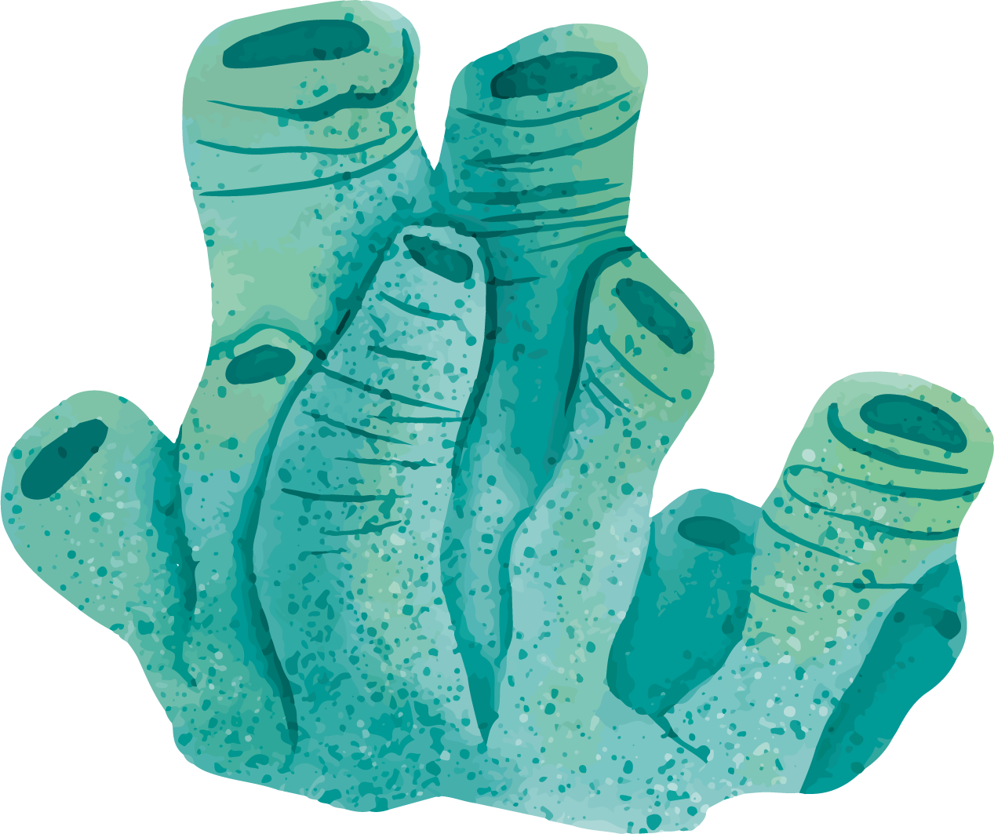

CHARACTERISTICS OF BIORESERVE
A land/marine/coastal area in which people are an integral component.
Regional centre for monitoring, research, education and training.
Developing a model programme for managing land and water.
Symbol of voluntary cooperation and use resources.
Notes:
If any one of you is interested in this, You can show your help through some NGO’s
You get lot of events, wherein you clean the beach, you get to socialize with people there.
In the end, You do something benefitting the world that’s fiving us plca and life.

Slide 16
BIORESERVES IN TAMIL NADU
GULF OF MANNAR BIOSPHERE RESERVE
NILGIRI BIOSPHERE RESERVE
India’s first marine biosphere reserve.
India’s first biosphere reserve and first hill biosphere reserve too.

Slide 17
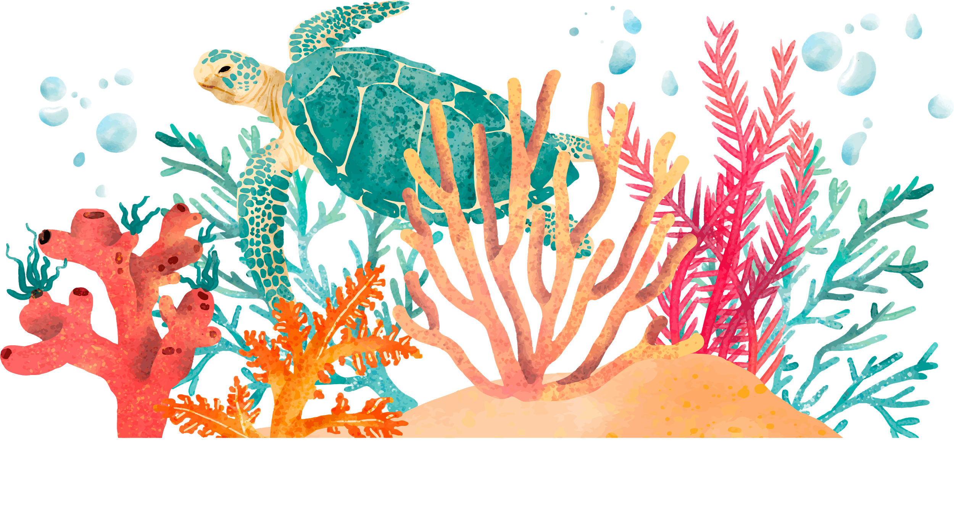
ORGANISATIONS INVOLVED IN BIODIVERSITY CONSERVATION
WWF
RFF
The NC
4. WRI
5. IUCN
6. AWF
7. GRAIN
8. ISF
9. BSP

Slide 18
PROJECT TIGER
This programme was launched in 1973. This was started with the protection of nine tiger reserves located in different habitats. Currently there are 23 tiger reserves.
Notes:
For the recent surbey, they started using automate tools, wherein they can the footprints to caluculate. Further they had cameras all over the hotspots and they use ML algorithms to differentiate togers based on their strips. No two tiger have identical stripes over them.
Project Tiger has succeeded in fulfilling its mandate and is one of the most successful conservation programmes for a single species in the entire world
Up by 30% with 2,226 tigers in 47 reserves

Slide 19
THANKS!
Special Thanks to 17pw18
Any questions?

